Slide 1
Reinforcement Learning in Airsim for Autonomous Driving
Presented By: Nachiket Patel

Slide 2
Motivation
Autonomous driving is becoming more prevelent
Experiment with implementing on a virtual environment to understand the difficulties of reinforcement learning
Self driving cars are cool !

Slide 3
Project Outline
Implement a reinforcement learning agent to operate in Airsim virtual environment
Utilize vitual sensors in the environment
Utilize a Deep Q Network for reinforcement learning
Experiment with different cost functions to improve on baseline

Slide 4
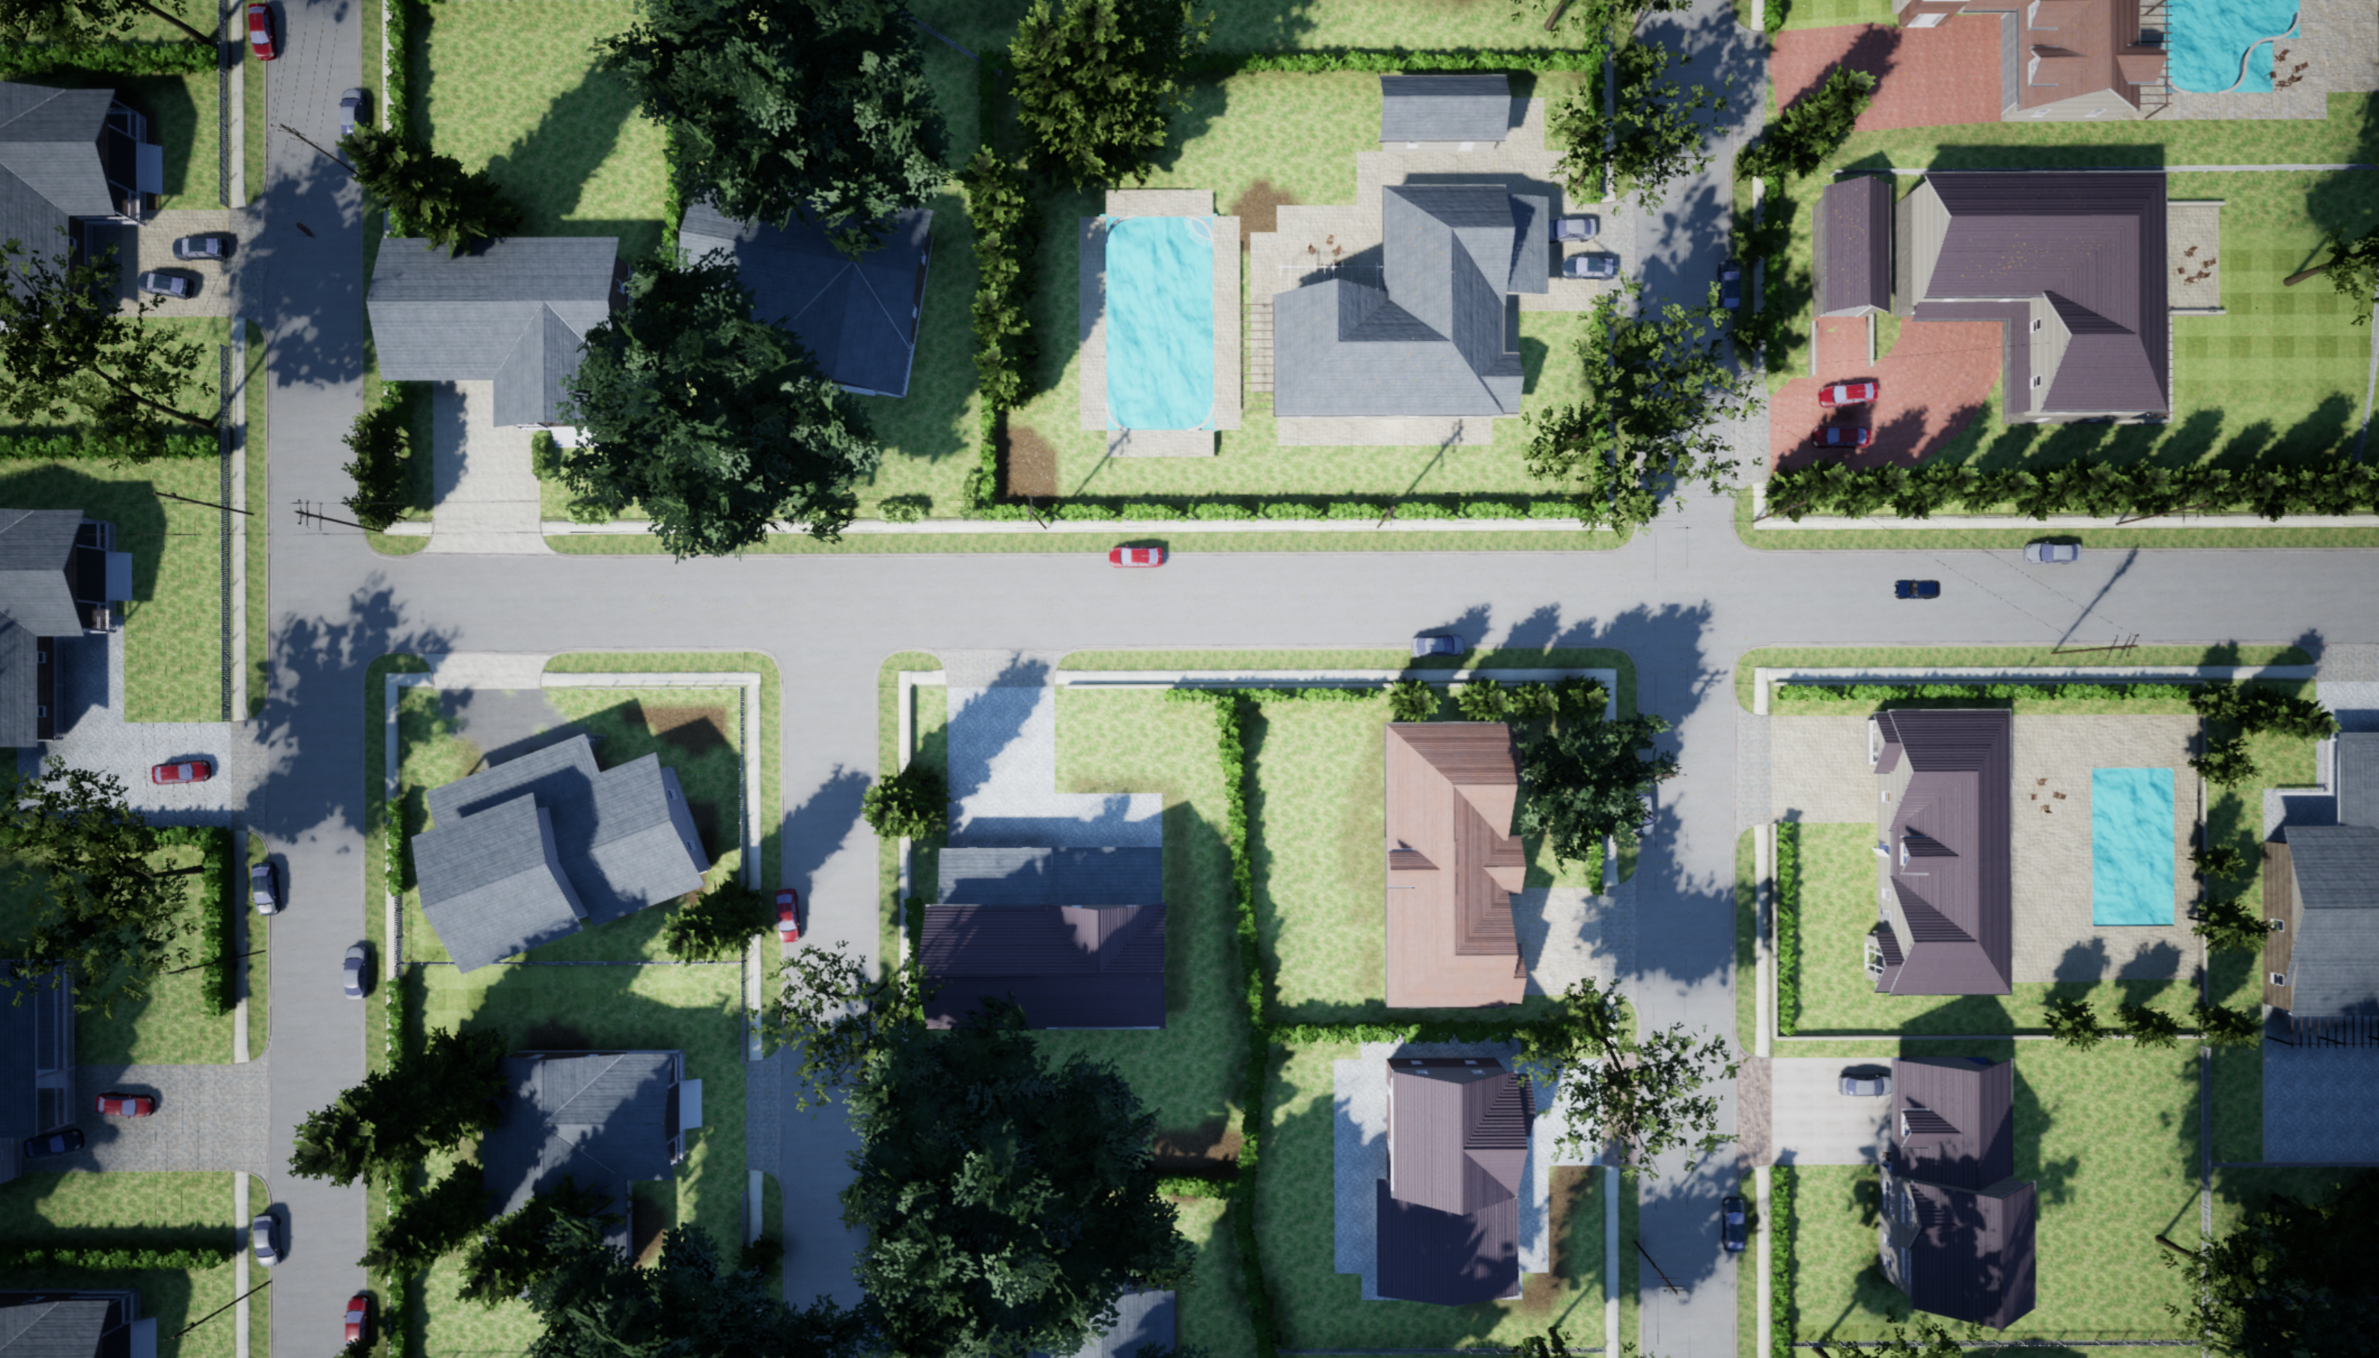
What is Airsim?
Microsofts virtual environment for training cars and drones
Built on the Unity game engine
Allows the user to define their own ground truth
Provides simulation of real life sensors to collect data and train agents

Slide 5
Design
A neighbourhood environment was select as the training ground
Discrete set of actions the agent could perform
Steering percentage
±0.00, ±6.25, ±12.50, ±18.75, ±25.00, ±31.25, ±37.75, ±43.75, ±50
Accelerator percentage
12.50, 25.00, 37.50, 50.00, 62.50, 75.00, 87.50, 100.00
Break percentage
0, 100
Use virtual sensors to acquire information about the environment
Objects, road width
Define partial ground truth for steering angle

Slide 6
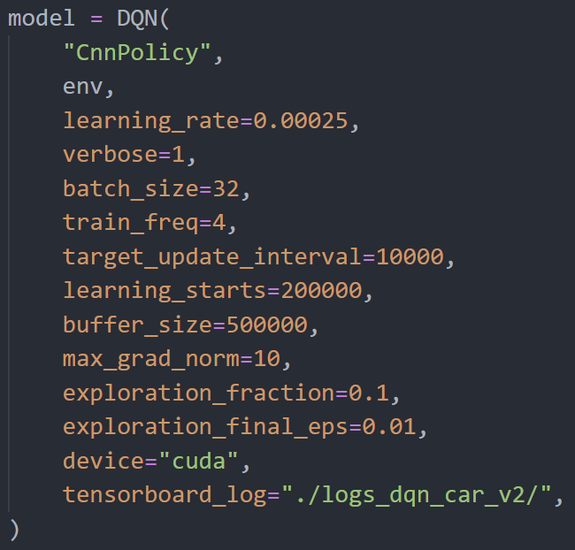
Design - DQN
Learning rate was very critical
High learning rate caused the agent to get stuck in a local max (reward)
Low learning rate was used but this made the training process very slow
Limited training time constrained the amount of hyper-parameter tuning possible.
Trained on Azure NV6 VM
1/2 Nvidia M60

Slide 7
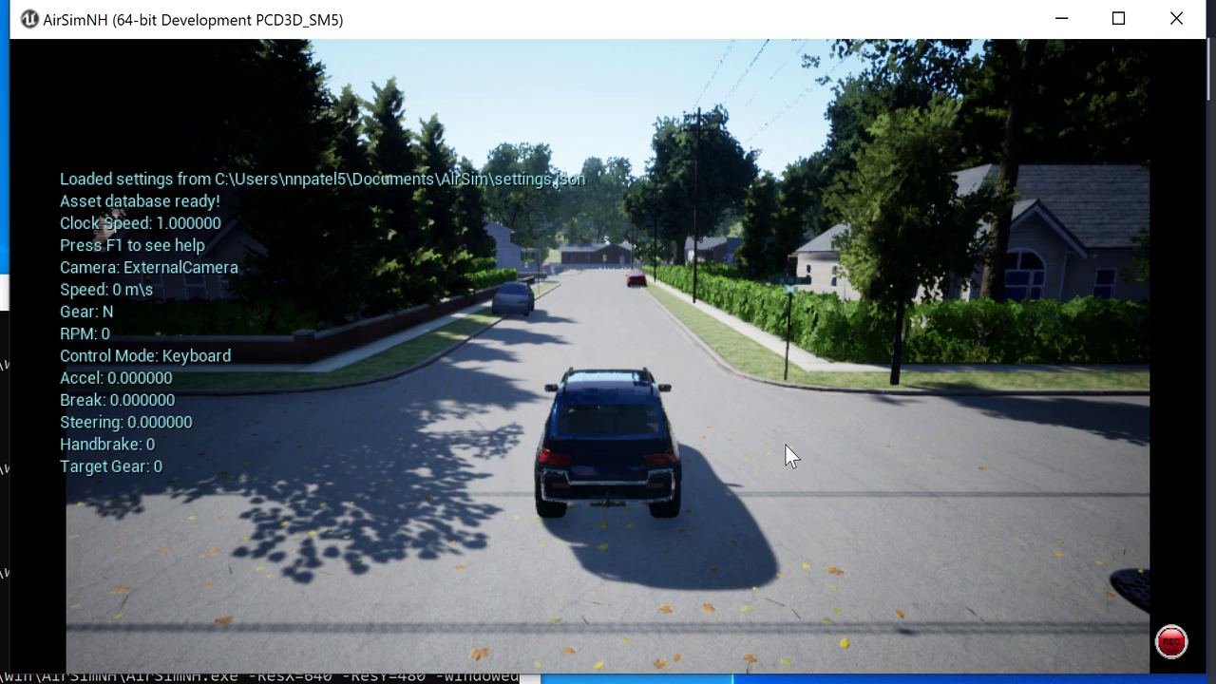
Results

Slide 8
Summary/ Future Work
Results can be be improved with longer training periods
Hyper parameter tuning should help increase the performance
Use different variants of the DQN to get better performance such as QRDQN
Look into methods such as learning by cheating

Slide 9
Thank You Questions

